Slide 1
“Bankruptcy Prevention”
ExcelR DataScience internship
Batch No. : G10

Slide 2
Introduction
This Project aims to create a tool that banks can use to make informed decisions about extending loans or credit to businesses. By leveraging historical data on companies' financial performance and external factors impacting their industries, the model can predict the likelihood of default or financial distress for a given borrower.
The data file contains 7 features about 250 companies
The data set includes the following variables:
1. industrial_risk: 0=low risk, 0.5=medium risk, 1=high risk.
evaluates the level of risk associated with the industry in which the company operates. In terms of stability, market demand, and susceptibility to economic downturns.
2. management_risk: 0=low risk, 0.5=medium risk, 1=high risk.
competence and effectiveness of the company's leadership in managing its operations.
3. credibility: 0=low credibility, 0.5=medium credibility, 1=high credibility.
Credibility reflects the reputation and trustworthiness of the company in the eyes of investors, creditors, and other stakeholders.

Slide 3
4. financial flexibility:
0 = low flexibility, 0.5 = medium flexibility, 1 = high flexibility.
Measures the company's ability to manage its financial obligations and adapt to changing circumstances. A high level of financial flexibility suggests that the company has sufficient liquidity, access to capital, and manageable debt levels.
5. competitiveness:
0 = low competitiveness, 0.5 = medium competitiveness, 1 = high competitiveness.
Assesses the company's ability to maintain market share, generate profits, and sustain growth in a competitive environment.
6. operating_risk:
0 = low risk, 0.5 = medium risk, 1 = high risk.
Refers to the potential for losses arising from operational failures, such as production disruptions, supply chain issues, or regulatory compliance failures.

Slide 4
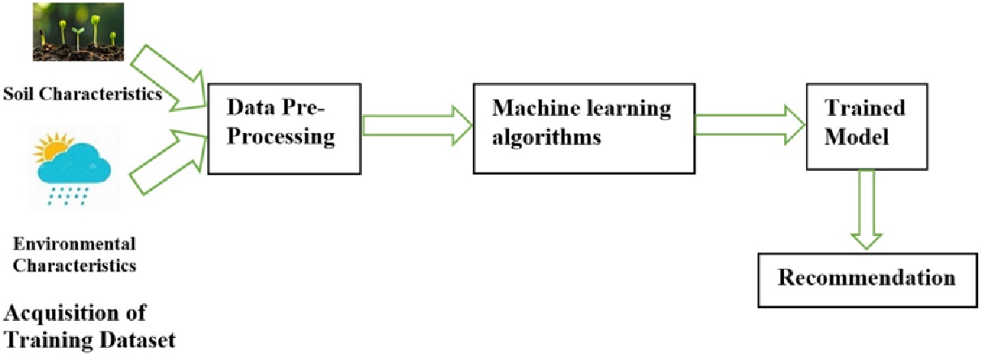
Business Objective:
This is a classification project, since the variable to predict is binary (bankruptcy or non-bankruptcy). The goal here is to model the probability that a business goes bankrupt from different features.
Data Pre- processing
EDA
Classification

Slide 5
Technologies used
Python
Utilized for data pre-processing, EDA and model development due to its extensive libraries for machine learning and data analysis.
JavaScript
Used for front-end development to create an interactive user interface.
Machine Learning Libraries:
Scikit-learn: Employed for implementing the Random Forest algorithm.
Pandas: Utilized for data manipulation and preprocessing tasks.
NumPy: Used for numerical computations and array manipulation.
Web Development Frameworks:
Flask: Employed for developing the back-end server to handle user requests, execute prediction algorithms, and serve recommendations.

Slide 6
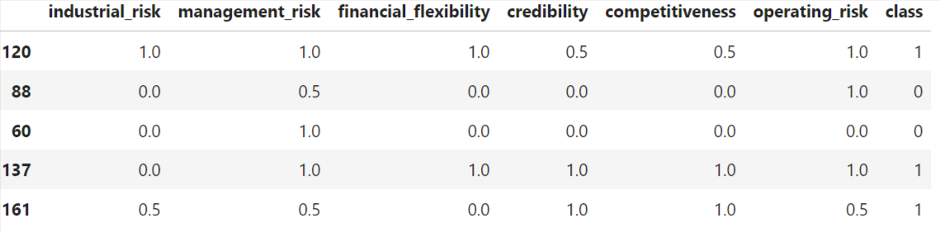
Implementation
1. Dataset Pre-processing:
Initially the data looks like 0.5;0;0;0;0;1;bunkrupt so I used
Excel > Data > Text to column, to separate them into 7 different columns
Using label encoding we converted output as 0 = bankruptcy, 1 = non-bankruptcy

Slide 7
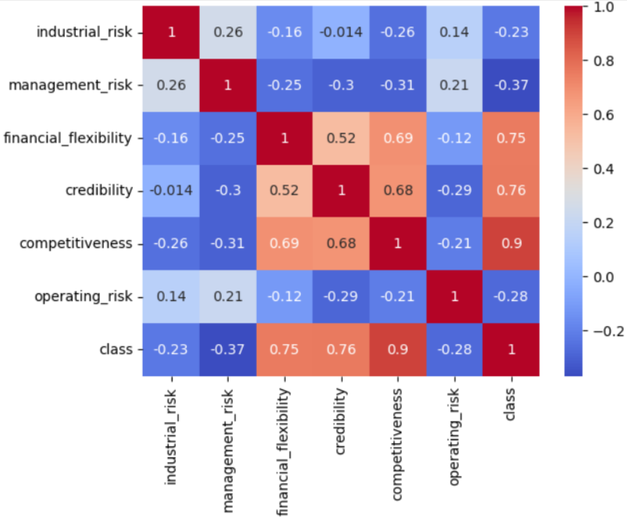
Exploratory Data Analysis
There are 250 rows and 7 columns and all the values are numeric of value 0 or 0.5 or 1.
Next we need to know if there are any relationships between data fields using correlation matrix.

Slide 8
Model Development
80% of the data is used for training and 20% for testing the model.
Implemented the Random Forest algorithm using the Scikit-learn library.
Trained the model on the pre-processed dataset, optimizing hyperparameters such as the number of trees to improve the prediction accuracy.
Evaluated the model's performance using accuracy_score, precision, recall.
Backend Development
Developed a backend server using Flask or Django to handle user requests, execute prediction algorithms, and serve recommendations.
Integrated the trained Random Forest model with the backend server to enable bankruptcy predictions based on user input.

Slide 9
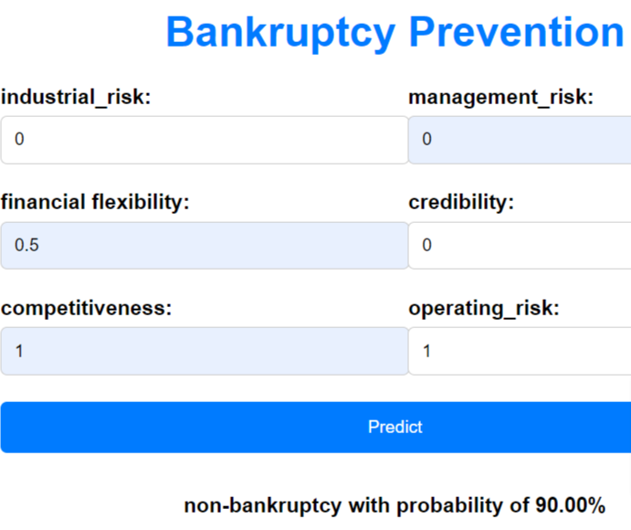
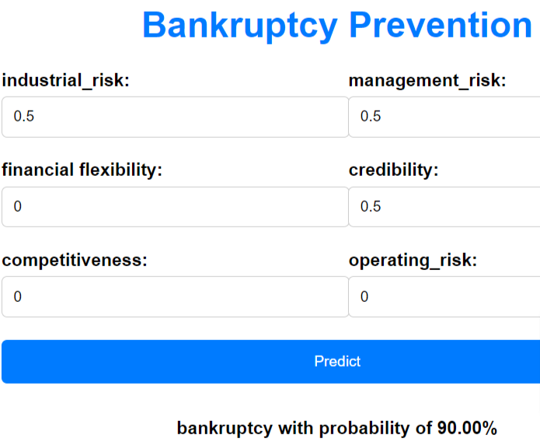
Results Accuracy using Randomforest is 100%

